Slide 1

CREDIT CARD FRAUD DETECTION
SRM INSTITUTE OF SCIENCE AND TECHNOLOGY
FACULTY OF ENGINEERING AND TECHNOLOGY
DEPARTMENT OF DATA SCIENCE AND BUSINESS SYSTEMS
21CSS202T FUNDAMENTALS OF DATA SCIENCE
- Project Review 2
Team members
1. Ra2311056010308 :-Aakriti
2.Ra2311056010251:- Rohan kumar
3.Ra2311056010287 :- Lakshya kumar

Slide 2
Table of contents
Abstract
Objectives
Architecture diagram
Sample Dataset

Slide 3
ABSTRACT
Credit card fraud has become a significant issue in the modern financial landscape as online transactions grow rapidly. Detecting fraudulent activities in real-time is essential to minimize financial losses and ensure the safety of users. This paper presents an overview of various techniques used to detect credit card fraud, focusing on machine learning and statistical models. By analyzing historical transaction data, these models can identify suspicious activities based on patterns, anomalies, and behavioral analysis.

Slide 4
OBJECTIVE
Fraudulent Transactions:- Transactions made using stolen or counterfeit credit card information without the authorization of the cardholder. Detecting these transactions is the primary goal of the system.
Data Privacy:- Ensuring that all personal and transaction data used in fraud detection models is securely handled and complies with relevant privacy regulations.
Feature Engineering:- The process of selecting and transforming variables (e.g., transaction amount, location, time of day) that help the model accurately distinguish between legitimate and fraudulent activities.
Machine Learning Models:- Algorithms used to predict whether a transaction is legitimate or fraudulent based on patterns and features extracted from historical data.

Slide 5
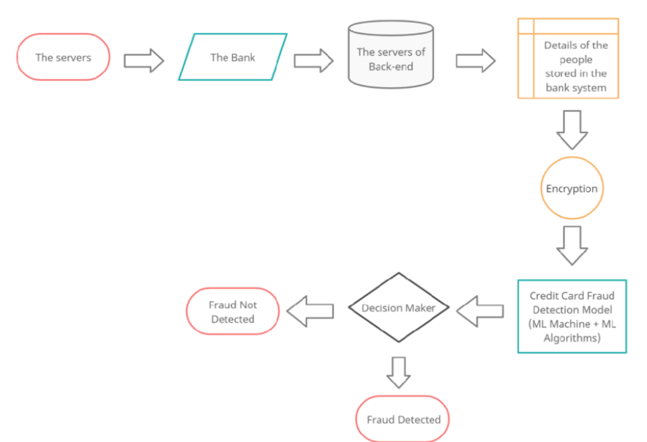
ARCHITECTURE DIAGRAM

Slide 6
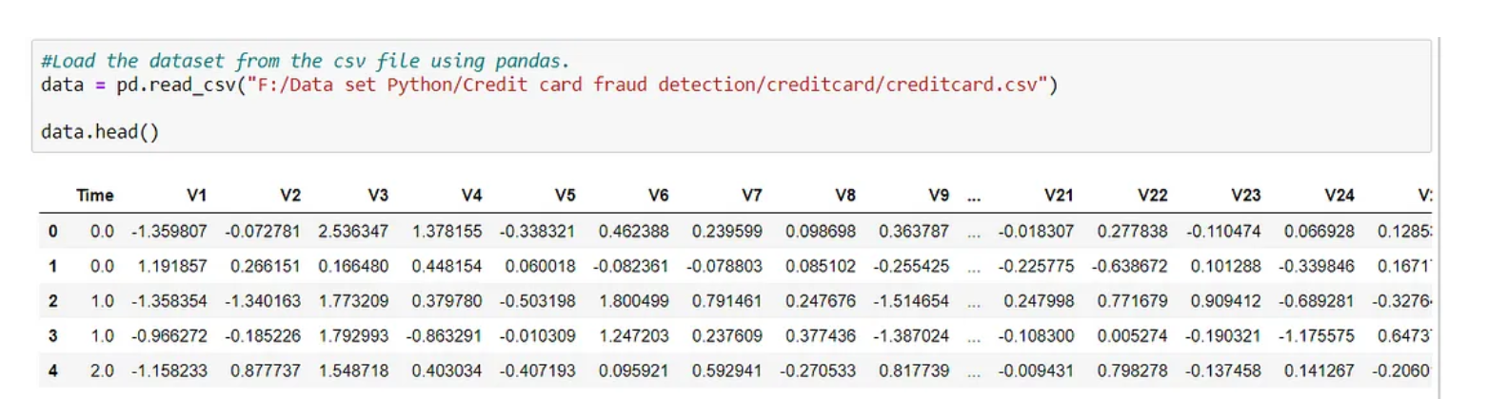
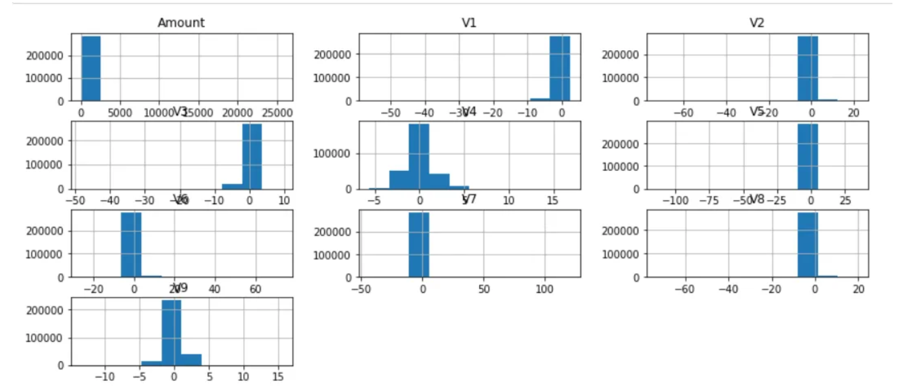
SAMPLE DATASET

Slide 7
THANKS

